Slide 1
Probability for ML
Let’s take a chance.

Slide 2
Terminologies
Outcome
Random experiment
Random event
Sample Space
Mutually exclusive events
Union and intersection of two (or more) events
Null event
Notes:
Basically QA session :
Outcome : refers to the end result of an experiment.
REx : outcome unknown in advance
REv : An outcome (also called elementary set) /set of outcomes.
Sample Space : Set of all possible outcomes.
MuExE : Disjoint events.

Slide 3
Definition of Probability
Relative frequency definition : Conduct an experiment with n outcomes. If an event A occurs n_{A} times, then the probability of A is defined as :
P(A) = lim _{n→inf} n_{A} / n
Classical definition : One does not need to conduct experiment. It is defined as :
P(A) = N_{A} / N, where N_{A} = number of times favorable outcome N = number of total outcomes.
Notes:
Relative freq definition example : Coin toss many times and actually note down results.
Classical definition : rolling an unbiased die, assuming that any number turning up is one out of six, so ⅙ will be the prob. According to the definition

Slide 4
Axiomatic definition
All probabilities are between 0 and 1: 0 ≤ P(A) ≤ 1
Valid propositions (tautologies) have probability 1, and unsatisfiable propositions have probability 0: P(true) = 1 ; P(false) = 0
The probability of a disjunction is given by:
P(A ∪ B) = P(A) + P(B) – P(A ∩ B)

Slide 5

Conditional Probability
S : Entire sample space M : An event contained in S A : An event contained in S
P(M) != 0
A and M when mutually exclusive, if P(A ∩ M) = P(A)P(M)
S
M
A

Slide 6
Total Probability and Bayes theorem
A2
A1
A4
A3
B
Notes:
S : Sample Space
B : arbitrary event
B : B intersection S. Split S into A1, A2, … AN disjoint parts.
So, B = B intersection with (A1, A2, … , AN)
That is, B = BA1, BA2, …, BAN (all are mutually exclusive)
P(B) = P(BA1) + P(BA2) + P(BA3) + … + P(BAN) → TOTAL PROB THEOREM
From conditional prob, P(BA1) = P(B/A1)P(A1)
Hence, Baye’s rule : P(AB) = P(B/A)P(A) = P(A/B)P(B)

Slide 7
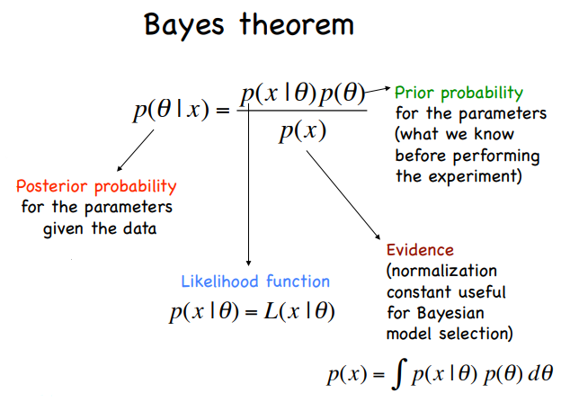
Slide courtesy : K Basu, https://astro.uni-bonn.de/~kbasu/ObsCosmo/Slides2012/Lecture3_2012.pdf

Slide 8
Random Variables
It is not a variable but a function that transforms or maps outcomes of a random experiment to real values.
Consider a random experiment of throwing a dice.
S = {S1, S2, S3, S4, S5, S6} Let X(S_{i}) = i, i.e. X(S₁) = 1 to X(S₆)=6

Slide 9
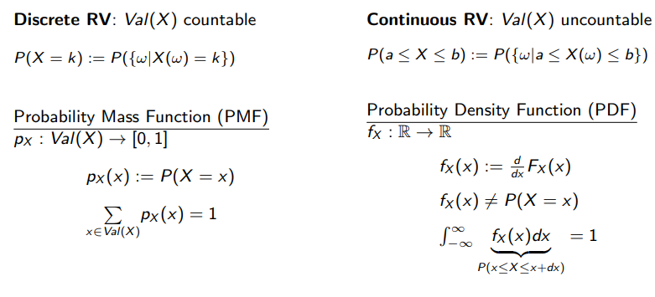
Discrete v/s. Continuous RV
Slide courtesy : CS229 stanford course : http://cs229.stanford.edu/section/cs229-prob-slide.pdf

Slide 10
Cumulative Distribution Function
F_{x}(x) = P(X<=x),
It is defined as the probability of that event comprising of all the sample points which are transformed by X into real numbers less than or equal to x.
Considering the example above,
F_{x}(1) = P(X<=1) = ⅙ F_{x}(2) = P(X<=2) = 2/6 = ⅓ and so finally, F_{x}(6) = P(X<=6) = 1
Notes:
Counter-example for the argument stated :
Let A = {S1, S2}, B = {S3, S4, S5}, C = {S6},
P(A) = ⅓ , P(B) = 1/2 , P(C) = ⅙
Let the transformation be : X(S_{i}) = i
Now, P[S : 3.5<X<=4.5] = P(S4), since S4 is not in the sample space, the RV defined is not possible.

Slide 11
Statistical Measures
Expected value or Mean
Standard Deviation / Variance : It answers the question, “How much is our RV away from the expected value?”
Median
Mode
Covariance (Joint distributions) : E[(x-E[x])(y-E[y])]
Correlation

Slide 12
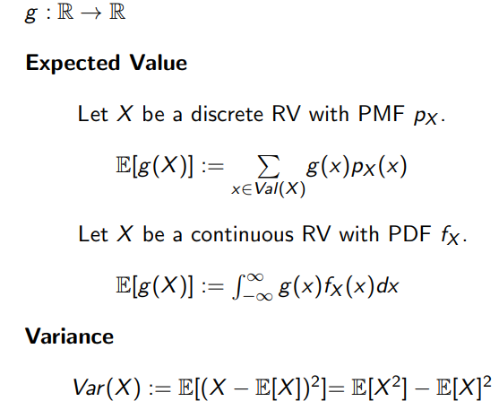
Expected Value and Variance
Slide courtesy : CS229 stanford course : http://cs229.stanford.edu/section/cs229-prob-slide.pdf

Slide 13
Types of Distributions - Discrete RV
Bernoulli Distribution :
A RV ‘X’ is said to have a Bernoulli distribution if it has 2 possible values 1/0 with P(X=1) = p and P(X=0) = 1-p
Mean : p
Variance : p(1-p)

Slide 14

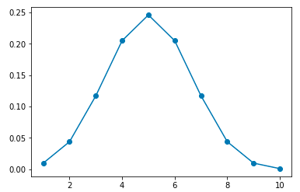
Types of Distributions (contd.)
Binomial Distribution :
Let’s do an exercise.
Mean : np
Variance : np(1-p)
Notes:
Talk about why binomial distribution important in real-world? -- Talk about the shop example and how things in analysis are binomial in nature.
Describe the plot for this distribution.
Tells us the significance of an event

Slide 15
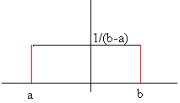
Types of Distributions - Continuous RV
Uniform Distribution : Uni(a,b)
Mean : ½(a+b)
Variance : 1/12(b-a)²

Slide 16
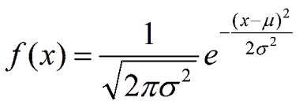
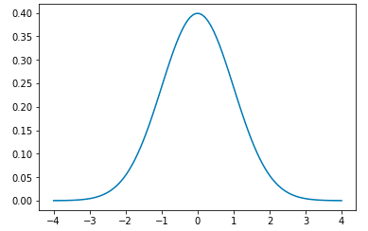
Types of Distributions (contd.)
Normal Distribution :
Mean : 𝞵
Variance : 𝞂

Slide 17
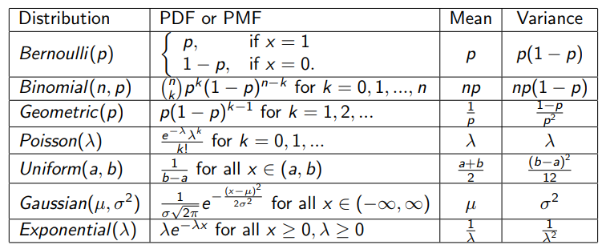
Slide courtesy : CS229 stanford course : http://cs229.stanford.edu/section/cs229-prob-slide.pdf

Slide 18
Joint Distribution
Consider 2 RVs, X & Y. They can be jointly characterized by joint CDF as
F_{XY}(x,y) = P(S : X(s)<=x, Y(s)<=y)
It represents the probability of all those sample points in s ϵ S such that under function X the transformed values are less than or equal to x and under the function Y, the transformed values are less than y.
Few Joint CDF functions to be included.
Marginal Densities.

Slide 19
Estimators
An estimator is any quantity calculated from the sample data which is used to give information about an unknown quantity in the population. For example, the sample mean is an estimator of the population mean m.
Results of estimation can be expressed as a single value; known as a point estimate, or a range of values, referred to as a confidence interval.
The usual estimator of mean is (⅀x_{i}/n) where n is the size of the sample. If the value of the estimator in a particular sample is found to be 5, then 5 is the estimate of the population mean µ.

Slide 20
Estimators
Unbiasedness: An estimate is said to be an unbiased estimate of a given parameter when the expected value of that estimator can be shown to be equal to the parameter being estimated. Unbiasedness is a good quality for an estimate, since, in such a case, using weighted average of several estimates provides a better estimate than each one of those estimates. Therefore, unbiasedness allows us to upgrade our estimates. For example, if your estimates of the population mean µ are say, 10, and 11.2 from two independent samples of sizes 20, and 30 respectively, then a better estimate of the population mean based on both samples is [20 (10) + 30 (11.2)] (20 + 30) = 10.75
Consistency: The standard deviation of an estimate is called the standard error of that estimate. The larger the standard error the more error in your estimate. The standard deviation of an estimate is a commonly used index of the error entailed in estimating a population parameter based on the information in a random sample of size n from the entire population.
Efficiency: An efficient estimate is one which has the smallest standard error among all unbiased estimators.

